Slide 1

MODEL INSTITUTE OF ENGINEERING AND TECHNOLOGY
MEMORY MANAGEMENT USING PAGING AND SEGMENTATION
SUBMITTED BY – SUBMITTED TO –
SANAM BHARDWAJ ASS.PROF MISS. SWATI GOYAL
RAHUL SHARMA
ADITYA SHARMA
VAIBHAV JAMWAL

Slide 2
CONTEXT
1.What is Memory Management
2.Paging
3.Segmentation
4.
5.
6.
7.

Slide 3

WHAT IS MEMORY MANAGEMENT?
Memory management can be defined as the process of controlling and coordinating computer memory, assigning portions that are referred as blocks, to various running programs to improve the overall system performance. The operating system, programs, applications, and hardware all have memory management systems.

Slide 4
PAGING
Paging is a memory management scheme that eliminates the need for contiguous allocation of physical memory. The process of retrieving processes in the form of pages from the secondary storage into the main memory is known as paging. The basic purpose of paging is to separate each procedure into pages.

Slide 5
Let us look some important terminologies:
Logical Address or Virtual Address (represented in bits): An address generated by the CPU
Logical Address Space or Virtual Address Space( represented in words or bytes): The set of all logical addresses generated by a program
Physical Address (represented in bits): An address actually available on memory unit
Physical Address Space (represented in words or bytes): The set of all physical addresses corresponding to the logical addresses
Example:
If Logical Address = 31 bit, then Logical Address Space = 2³¹ words = 2 G words (1 G = 2³⁰)
If Logical Address Space = 128 M words = 2⁷ * 2²⁰ words, then Logical Address = log₂ 2²⁷ = 27 bits
If Physical Address = 22 bit, then Physical Address Space = 2²² words = 4 M words (1 M = 2²⁰)
If Physical Address Space = 16 M words = 2⁴ * 2²⁰ words, then Physical Address = log₂ 2²⁴ = 24 bits

Slide 6
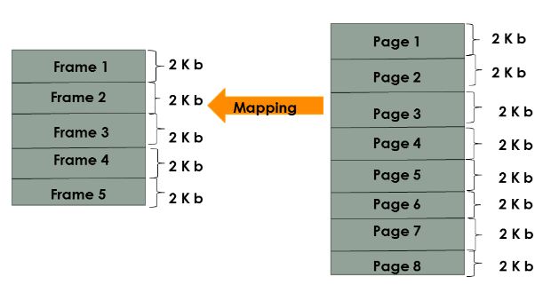

Slide 7
SEGMENTATION
In Operating Systems, Segmentation is a memory management technique in which, the memory is divided into the variable size parts. Each part is known as segment which can be allocated to a process. The details about each segment are stored in a table called as segment table. Segment table is stored in one (or many) of the segments.

Slide 8
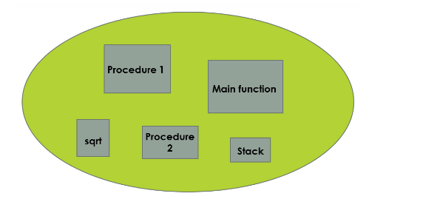
SEGMENTATION

Slide 9
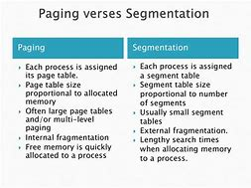

Slide 10
PROGRAM FOR MEMORY MANAGEMENT USING PAGING AND SEGMENTATION

Slide 11
#include<stdio.h>
#include<stdlib.h>
#define MAX 50
int paging()
{
int page[MAX],i,n,f,ps,off,pno;
int choice=0;
printf("\nEnter the no of peges in memory: ");
scanf("%d",&n);
printf("\nEnter page size: ");
scanf("%d",&ps);
printf("\nEnter no of frames: ");
scanf("%d",&f);
for(i=0;i<n;i++)
page[i]=-1;
printf("\nEnter the page table\n");
printf("(Enter frame no as -1 if that page is not present in any frame)\n\n");
printf("\npageno\tframeno\n-------\t-------");
for(i=0;i<n;i++)
{
printf("\n\n%d\t\t",i);
scanf("%d",&page[i]);
}

Slide 12
do
{
printf("\n\nEnter the logical address(i.e,page no & offset):");
scanf("%d%d",&pno,&off);
if(page[pno]==-1)
printf("\n\nThe required page is not available in any of frames");
else
printf("\n\nPhysical address(i.e,frame no & offset):%d,%d",page[pno],off);
printf("\nDo you want to continue(1/0)?:");
scanf("%d",&choice);
}while(choice==1);
return 1;
}
struct list
{
int seg;
int base;
int limit;
struct list *next;
} *p;

Slide 13
void insert(struct list *q,int base,int limit,int seg)
{
if(p==NULL)
{
p=malloc(sizeof(struct list));
p->limit=limit;
p->base=base;
p->seg=seg;
p->next=NULL;
}
else
{
while(q->next!=NULL)
{
q=q->next;
printf(“yes");
}
q->next=malloc(sizeof(struct list));
q->next ->limit=limit;
q->next ->base=base;
q->next ->seg=seg;
q->next ->next=NULL;
}
}

Slide 14
int find(struct list *q,int seg)
{
while(q->seg!=seg)
{
q=q->next;
}
return q->limit;
}
int search(struct list *q,int seg)
{
while(q->seg!=seg)
{
q=q->next;
}
return q->base;
}
void segmentation()
{
p=NULL;
int seg,offset,limit,base,c,s,physical;
printf("Enter segment table\n");
printf("Enter -1 as segment value for termination\n");

Slide 15
do
{
printf("Enter segment number");
scanf("%d",&seg);
if(seg!=-1)
{
printf("Enter base value:");
scanf("%d",&base);
printf("Enter value for limit:");
scanf("%d",&limit);
insert(p,base,limit,seg);
}
}while(seg!=-1);
printf("Enter offset:");
scanf("%d",&offset);
printf("Enter bsegmentation number:");
scanf("%d",&seg);
c=find(p,seg);
s=search(p,seg);
if(offset<c)
{
physical=s+offset;
printf("Address in physical memory %d\n",physical);
}

Slide 16
else
{
printf("error");
}
}
int main()
{
int choice;
while(choice!=3)
{
printf("1.paging \n 2.segmetation \n 3.quit \n enter your choice:");
scanf("%d",&choice);
if(choice==1)
{
paging();
}
else if(choice==2)
{
segmentation();
}
else if(choice==3)
printf("you quit");
}
}

Slide 17
THANK YOU

